Slide 1
3H-PSNet
Hierarchical PointSAM with contrastive refinement and risk-aware distillation for 3D semantic segmentation

Slide 2
Abstract
We present 3h-psnet, a novel framework for point cloud segmentation that extends the use of PointSAM-Pointly Supervised Segment anything model for remote sensing images to 3D images via a hierarchical multi-head structure. Our model addresses two primary challenges in 3d segmentation: spatial ambiguity between adjacent parts and varying point-wise learning difficulty. We use NPC( negative point contrast) refinement head that dynamically identifies and subtacts confusing part features. Simultaneously, we deploy a risk prediction head to distill geometric hardness and a PBR (prototype based regularization) head to ensure global feature consistency. Experiments on ShapeNetPart demonstrate that our hierarchical backbone and blended mining strategy outperform State-of-the-art Models, achieving robust segmentation across diverse categories.

Slide 3
Problem
Recent adaptations of SAM to 3d point clouds rely heavily on standard mlps( Multi-layer perceptron) or transformers( like ViT modules) that treats points as independent tokens.
Let a PC be defined as P = {pi} i=1 to N belongs to R N*3
Standard approaches each point pi through a function phi( pi) independently.
This leads to geometric semantic ambiguity, where points at the boundary of a “chair leg” and “chair seat” have similar coordinate value but distinc semantic labels.
Without local neighbourhood context N(pi), the model fails to capture the fine grained curvature changes that define 3d parts.

Slide 4
Contribution
Hierarchical Backbone: Set Abstraction (SA) mechanism to encode multi-scale geometry
Contrastive Refinement: A negative point contrast that resolves boundary ambiguity using overlapping IOU logic in 3d point clouds.
Risk-aware blended mining: A learning strategy utilizing our novel inverted mu-relief logic to focus training on geometrically complex and ambiguous regions.

Slide 5
Methodology
Attached as pdf
https://drive.google.com/file/d/13H3t3Y6BE7YQP9nDAOTNISdmTRCXbh3x/view?usp=drive_link

Slide 6
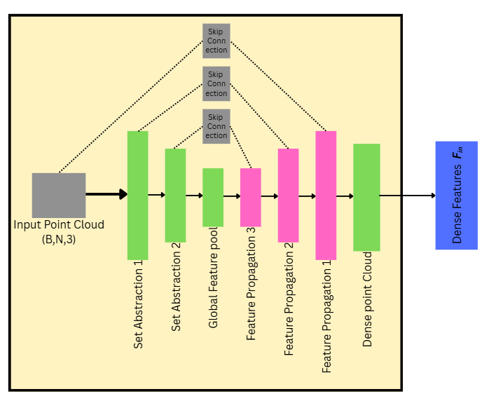
Backbone

Slide 7
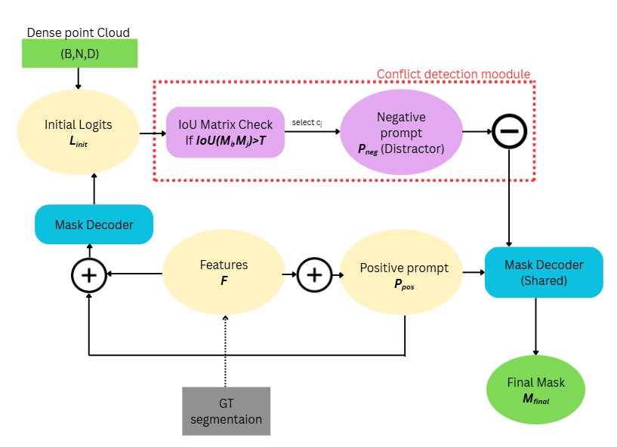
Head 1: Negative Point contrast refinement

Slide 8
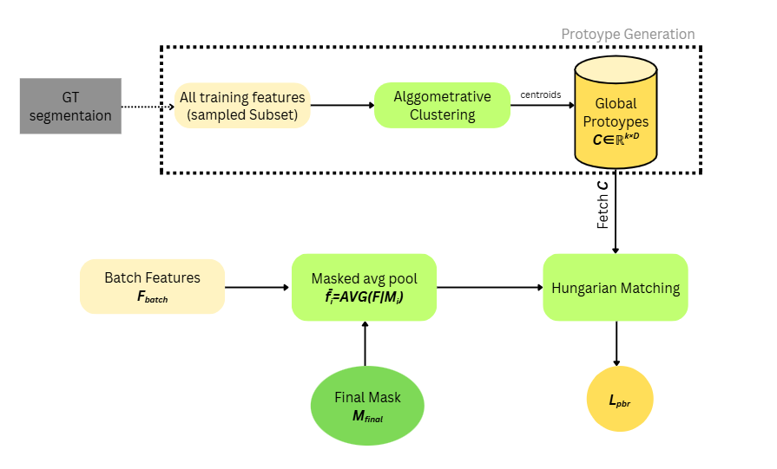
Head 2: prototype matching

Slide 9
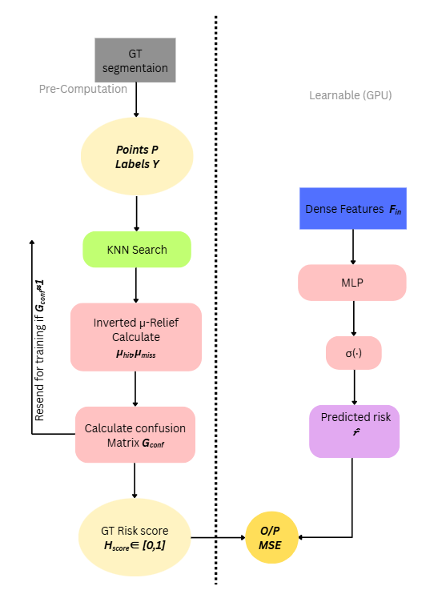
Head 3: risk detection & distillation

